Slide 1
\LaTeX
For Scientific Documentation
By Ammar Taha Mohamedy
LaTeX Counters and Lengths

Slide 2
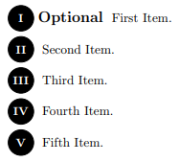
Counters Scope
Counters are used to keep track of various numeric values, such as page numbers, section numbers, equation numbers, etc.
They are global variables (of type integers) for counting objects.
We can define new counters for our sake, and modify their values in different ways throughout the document.
New Ordered Structures
Custom Enumerated Lists
Looping
For example: new numbered theorem-like environments that use a dedicated formatted counter.
Like “While” statement that operates based on the value of a counter while some related condition remains true.

Slide 3
About \leavevmode
https://tex.stackexchange.com/questions/22852/function-and-usage-of-leavevmode
https://texfaq.org/FAQ-noline

Slide 4
\whiledo from ifthen Package
\whiledo{test}{
actions/routines
}
Actions/Routines are executed repeatedly until test becomes false.
We need counters to determine how many times we would like to repeat the actions, and to stop the loop.

Slide 5
Thanks for Watching !!

